Slide 1
^{Zonta, Gender Equity, and} ^{a Vision for 2030 & Beyond} Strategic Plan Goals and Strategies 2023–2030

Slide 2
Zonta International Convention
Zonta International President
International Board
Zonta Foundation for Women President
Foundation Board
International Headquarters
International Committees
Districts __________________ Governor
District Boards
District Committees
District Foundation Ambassadors
District Foundation Ambassadors
Areas ______________ Area Directors
Clubs _____________ Club Presidents
Club Board
Club Committees
Club Members

Slide 3
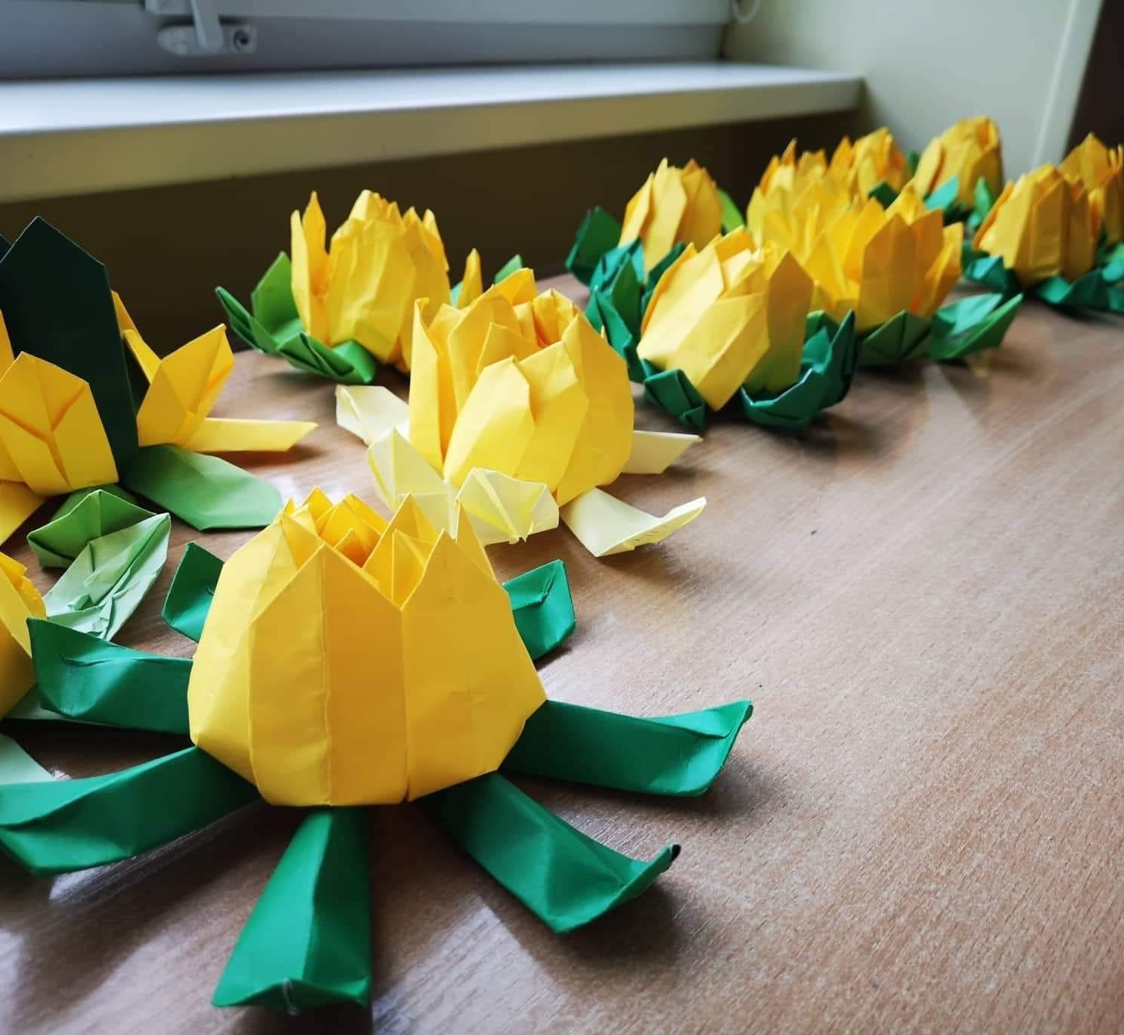
Develop a new strategic plan to meet the needs of Zonta members while opening new pathways
for other gender equity advocates to engage with Zonta
THE OBJECTIVE
Notes:
One of the goals for this biennium was to develop a strategic plan to meet the needs of Zontians while opening new pathways for other gender equity
advocates to join us in our efforts.
Building on the work on Resolution #2 in the last two biennia, which included an overall review of the organization, the International Board developed a future-focused strategic plan that sets a long-term strategy for Zonta through 2030.
This plan was shared with all members on the website, in social media posts, in online sessions, and now at district conferences.

Slide 4
The plan will be developed in year one of the biennium and shared with all members.
The plan was formulated from significant reviews during the past biennium and this biennium into Zonta’s operations
THE OBJECTIVE

Slide 5
We will expand its credibility and visibility in the world on key advocacy issues
To be successful, there must be faith in the clubs and members must enjoy a healthy club life
We must seek new members, allies and partners who believe in our mission to build a better world for women and girls
KEY
PRINCIPLES
Notes:
As we developed the plan, some key principles emerged.
Zonta International needs to expand its credibility and visibility:
advocacy will be key in our work to become seen and heard
Our organization is nothing without our members - clubs and supporting members - so Zontians need to find it motivating to be a part of our organization. A healthy club life is therefore essential and all of us have a role in it.
When working towards our mission we need more new members. But we also need more cooperation - new allies and partners.

Slide 6
Zonta will not change
We will remain a place where globally minded individuals connect, collaborate and demand change to build a better world for women and girls.
But we must remain relevant for the future
We must be open to change to continue as a sustainable and strong community of individuals working together for gender equity.
KEY
PRINCIPLES
Notes:
There are many things which are working very well in our organization.
At the core, Zonta will not change.
But it is clear: all of us need to be positive about changes IF we want to be relevant for the future AND IF we want to be effective in building a better world for women and girls.
Sticking to the past will not bring us forward.

Slide 7
UPDATE TO MISSION
Zonta International is a leading global organization of individuals working together to build a better world for women and girls.
Notes:
When drafting the strategic plan, it also quickly became clear for us that our plans for the future fit well under the motto of this biennium “build a better world for women and girls.”
That made it necessary to update our Zonta mission to incorporate this motto, as well as recent bylaws changes that address Zontians as “individuals.”
The updated mission statement is now:
“Zonta International is a leading global organization of individuals, working together to build a better world for women and girls.”

Slide 8
2023-2030: OUR MISSION & GOALS
Mission: Zonta International is a leading global organization of individuals working together to build a better world for women and girls.
Goal 1: Credible and Visible Voice
Zonta acts as a credible and visible voice on gender equity and delivers initiatives addressing education equality, climate justice, ending gender-based violence, and ensuring women are represented in decision-making positions on an equal basis with men.
READINESS FOR THE FUTURE WILL REQUIRE…
Goal 2: Club Success
Clubs serve as a welcoming and inspiring environment to those who wish to work to empower women and girls and create information and resources necessary to focus on the most important issues facing women and girls.
Goal 3: International Leadership & Sustainability
Zonta manages its resources, including both time and money, to meet the vision and ensure the organization’s long-term viability and success. Zonta modernizes its governance structure to align with its strategic plan, ensure innovative thought and allow for effective decision-making.
Goal 4: Engagement of Audiences & Alliances
Zonta creates customized pathways to connect to Zonta, develops collaborations with like- minded organizations, and expands revenue streams to further our mission and extend our voice.
Notes:
The strategic plan is a seven-year plan, taking us through 2030. There are four main goals.
First: being a credible and visible voice Second: having a focus on our members and on healthy club life,
Third: going forward there is a need to modernize our governing structures, and,
Fourth: we cannot make a difference by just ourselves; we need like-minded partners and allies to support us in our work.
Please note that we have carefully chosen the words in Goal #1 to be “gender equity” and not “gender equality.”

Slide 9
EQUITY
EQUALITY
Resources given based on needs
Everyone gets the same resources
Situation focuses on everything being fair,
in regards of current status
Situation focuses on everything being the same, regardless of current status
Outcome is equal
Outcome is not equal
www.zonta.org
Notes:
While the words sound similar, the definitions and practical usage are different.
As you can see here in the right picture, treating women and men equally might not actually be fair or doesn’t bring the result we want.We cannot minimize the gap between men and women.
Gender equity on the left picture recognizes that women are not in the same ‘starting position’ as men because of historical and social disadvantages. They may need more in certain fields to achieve the same level with men.
Equality is the end goal that we want to achieve, but equity is the means to get there.

Slide 10
2023-2030: OUR GOALS
1
Credible and Visible Voice
Zonta acts as a credible and visible voice on gender equity and delivers initiatives addressing education equality, climate justice, ending gender-based violence, and ensuring women are represented in decision-making positions on an equal basis with men.
1
Credible and Visible Voice
2
Club Success
3
International Leadership & Sustainability
4
Engagement of Audiences and Alliances
Notes:
Let’s now have a look at Goal #1.
Zonta acts as a credible and visible voice.
When we want to be more visible, we need actions through which we gain credibility, and we need to be involved in discussions on issues affecting
gender equity.

Slide 11
FOUR KEY ISSUES
Education equality
key issue for individuals to have a better future
recognized human right
historically Zonta has been active in the field of education
Climate justice
Climate change with a gendered lens
From natural disasters to food security, health, access to clean water and migration, our changing climate already has severe implications for women and girls
Risk for gender-based violence also increases
Gender-based violence
Women in decision making positions
Women must sit at the decision-making tables and contribute
Zonta works to break glass ceilings, windows, and walls.
Notes:
Education equality – Our commitment to education will continue through our Zonta International education programs and our advocacy for education equality for all women and girls.
Ending gender-based violence – Zonta Says NO will continue to grow as our flagship campaign to address gender-based violence.
Climate justice – We will fully embrace climate justice as an area of focus and further develop Zonta Says NOW as the centerpiece of our activities to address climate justice at local, national and international levels.
Ensuring women are represented in decision-making positions on an equal basis with men – We will continue to advocate for women to be present and active contributors at decision-making tables, as we work to break glass ceilings to women’s leadership.

Slide 12
THREE STRATEGIES
Provide a place for members to contribute their ideas
Focus on advocacy
Build credibility and visibility
Our actions and contributions will be global
Develop and deliver programs and initiatives which focus on the chosen areas
Expand Zonta’s international level content and communication strategies
Communication is the key to becoming credible and visible

Slide 13
2023-2030: OUR GOALS
2
Club Success
Clubs serve as a welcoming and inspiring environment to those who wish to work to empower women and girls and create information and resources necessary to focus on the most important issues facing women and girls.
1
Credible and Visible Voice
2
Club Success
3
International Leadership & Sustainability
4
Engagement of Audiences and Alliances
Notes:
Goal #2 is club success. Because we are a membership organization, our Zonta clubs are the backbone of our organization.
Our goal is that Zonta clubs:
serve as a welcoming and inspiring environment, to those who wish to work to empower women and girls and create information and resources, necessary to focus on the most important issues, facing women and girls.

Slide 14
FOUR STRATEGIES
Increase the focus on the value of Zonta clubs to deliver impact in their local communities
Expand the focus and support for forming and chartering new Zonta clubs
Recognize the rights of clubs and individuals to have self-determination
Encourage the Zonta Spirit for a happy and healthy club life and a diverse and inclusive environment.

Slide 15
2023-2030: OUR GOALS
3
International Leadership & Success
Zonta manages its resources, including both time and money, to meet the vision and ensure the organization’s long-term viability and success. Zonta modernizes its governance structure to align with its strategic plan, ensure innovative thought and allow for effective decision-making.
1
Credible and Visible Voice
2
Club Success
3
International Leadership & Sustainability
4
Engagement of Audiences and Alliances
Notes:
To ensure that Zonta thrives for the next 100 years it is vital that we have strong leadership and a sustainable organization.
Goal #3 encourages Zonta to manage its resources, including both time and money, to meet the
vision and ensure the organization’s long-term viability and success. Zonta modernizes its governance structure to align with its strategic plan, ensure innovative thought and allow for effective decision-making.

Slide 16
FOUR STRATEGIES
Sustain current sources of revenue while evaluating operational and cost structures for the future
Protect Zonta’s assets with prudent management and a long-term view of organizational health
Address governance, leadership and internal structures to enable the effective achievement of our mission
Enhance trust in the Zonta Foundation for Women for its work with unique and impactful programs which will attract donations and raise new funds from diverse avenues

Slide 17
2023-2030: OUR GOALS
4
Engagement of Audiences and Alliances
Zonta creates customized pathways to connect to Zonta, develops collaborations with like-minded organizations, and expands revenue streams to further our mission and extend our voice.
1
2
Club Success
3
4
Engagement of Audiences and Alliances
Credible and Visible Voice
International Leadership & Sustainability
Notes:
Let us now talk about Goal #4 - Engagement of Audiences &amp; Alliances.
Engagement of new audiences and allies can enable ZI:
To further our mission and extend our voice on gender equity in connection with Goal 1, and
To increase members and supporters in connection with Goal #2, and expand revenue streams in connection with Goal 3.
This is a cross-cutting goal that can boost the other three goals.

Slide 18
FOUR STRATEGIES
Aim for new audiences of gender equity advocates through marketing programs and engagement opportunities
Attract and welcome new members and supporters
Increase information and resources for our members
Expand alliances, partnerships, and sponsorships through new collaborations to to elevate Zonta’s message and diversify our revenue streams

Slide 19
THE TIMELINE
February
March
April
May
June
July
August
September
October
November
The Board meetings to finalize strategic plan.
Prepare the strategic plan for publication.
Publication of the strategic plan.
Informational presentations at the interdistrict meetings April to June 2023.
Member webinars on final strategic plan July – September 2023.
Zonta International Board representatives deliver presentations at district conferences.
Potential Zonta International Bylaws possible amendments investigated June – November 2023.
Notes:
Now that you have been introduced to the four strategic goals, how will we proceed?
Now having finalized the plan, the Board is taking the first steps in implementing the plan.
It is important to understand that we must be open to changes, but changes do not happen quickly. We cannot tackle all things at once and must prioritize.
At the convention in Brisbane, the biennial goals for 2024-2026 will be presented. The biennial goals will set the priorities for the next biennium in accordance with the Strategic Plan.
The Board is also investigating possible changes to the Zonta International Bylaws to be introduced at the next convention or thereafter.

Slide 20
WE NEED YOUR SUPPORT!
All Zontians have a role to play and are key to the success of this plan.
Strategies will be aligned at international, district and club levels.
Resources will be developed for districts and clubs to support alignment.
Notes:
The 2030 Strategic Plan has been developed to provide the framework for building a better world for women and girls, but we need your support!
The success of this plan will require the active engagement of our 32 districts, almost 1,100 Zonta clubs and 26,000+ Zontians, and strategies will need to be aligned at all levels of the organization.
We will be preparing resources for districts and clubs to use to develop their own strategic plans that align with the global goals and strategies but start thinking now about your district and club activities.

Slide 21
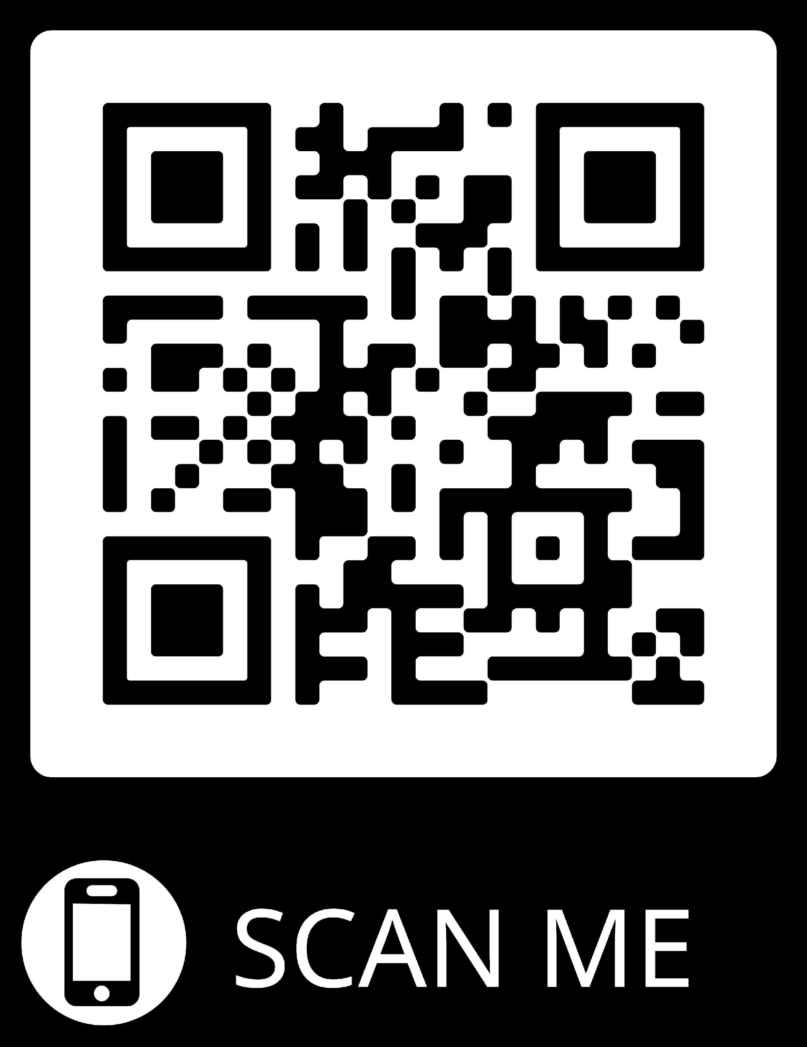
Find more information and follow the process at www.zonta.org/StrategicPlan.
FOLLOW
ALONG

